Slide 1
BOOK STORE APPLICATION USING MERN STACK
TEAM MEMBERS:
ASWITHA. B (au211521205020) DEEPA. A (au211521205030) HARSHITHA. G (au211521205052)
DHARSHIKA. T (au211521205033)

Slide 2
ABSTRACT
This bookstore website, powered by the MERN stack (MongoDB, Express, React, Node.js), represents a cutting-edge platform that combines speed, scalability, and dynamic user interaction. With real-time search functionality, personalized book recommendations, and a streamlined checkout process, the website offers a unique, tailored experience for book enthusiasts.
The use of MongoDB allows for efficient data storage of large book inventories, while React ensures an intuitive, responsive user interface. This modern technology stack positions the website to not only meet current user needs but also adapt to future growth and evolving trends in the online book market.

Slide 3
INTRODUCTION
Harnessing the power of the MERN stack, this bookstore website revolutionizes the way users explore and buy books online.
The seamless integration of MongoDB, Express, React, and Node.js provides lightning-fast performance, real-time updates, and smooth navigation, creating an enhanced user experience.
With a focus on personalization, the platform tailors book recommendations and content to individual users, making it more than just an e-commerce site.
By leveraging the flexibility and efficiency of the MERN stack, this bookstore website sets a new standard for innovation, ensuring scalability and long-term sustainability in the digital book retail space.

Slide 4
PROPOSED SYSTEM
This application is designed to give a seamless shopping experience by providing:
Simple navigation: Easier navigation and browsing through the categories such as home page, books, cart and order history.
Cart management: Once the cart is opened it provides features such as addition of books, easier navigation to previous pages, and the quantity of books added to cart.
Checkout: Once the cart is finalised then it is easier for checkout by giving our personal details, address for delivery.
Simple page checkout: Once the details for the checkout are given then the books will be ordered and the users can continue to shop on the website for more books.

Slide 5
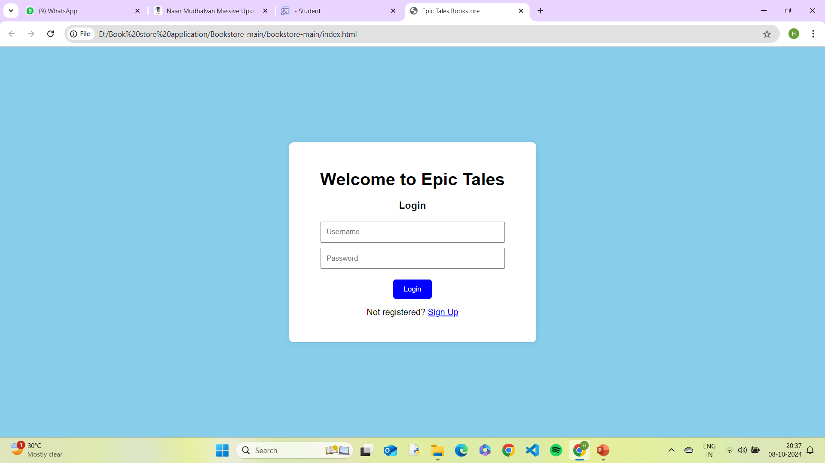
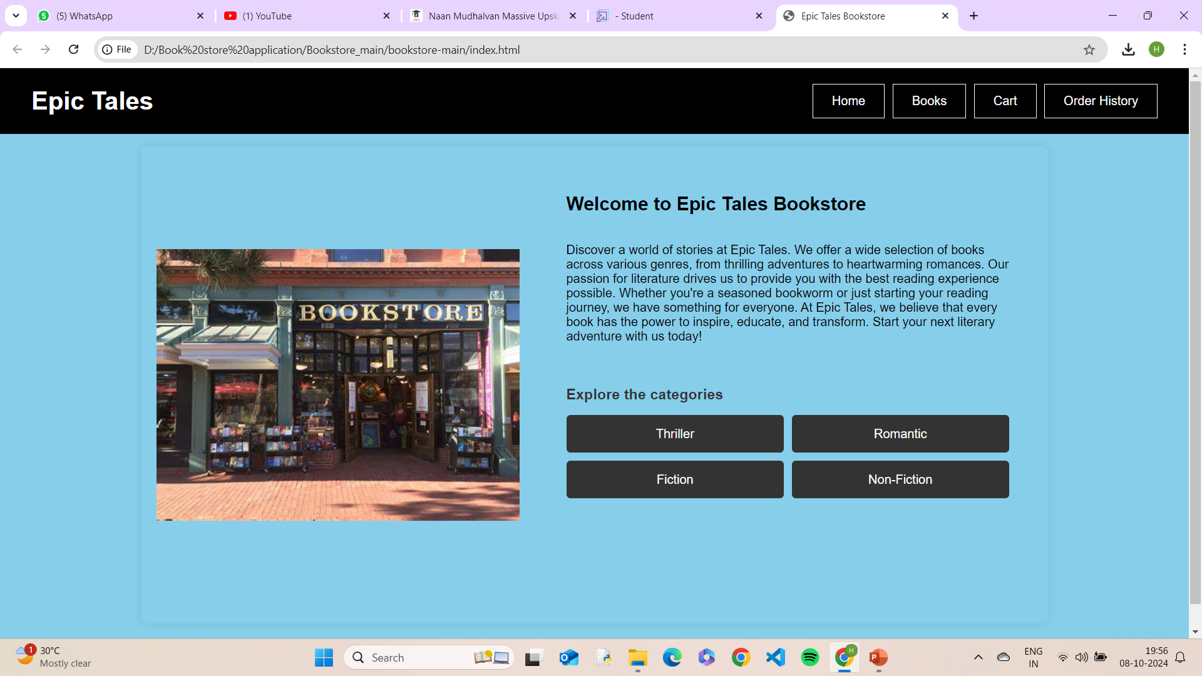
PROPOSED MODEL

Slide 6
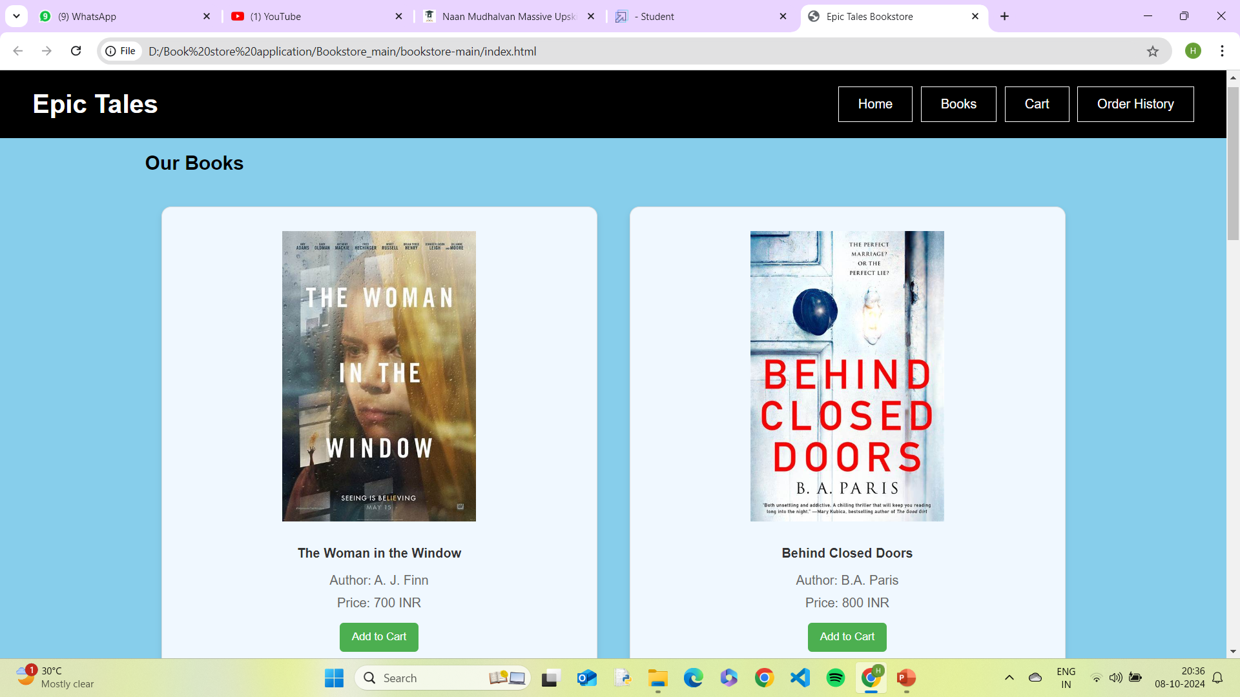
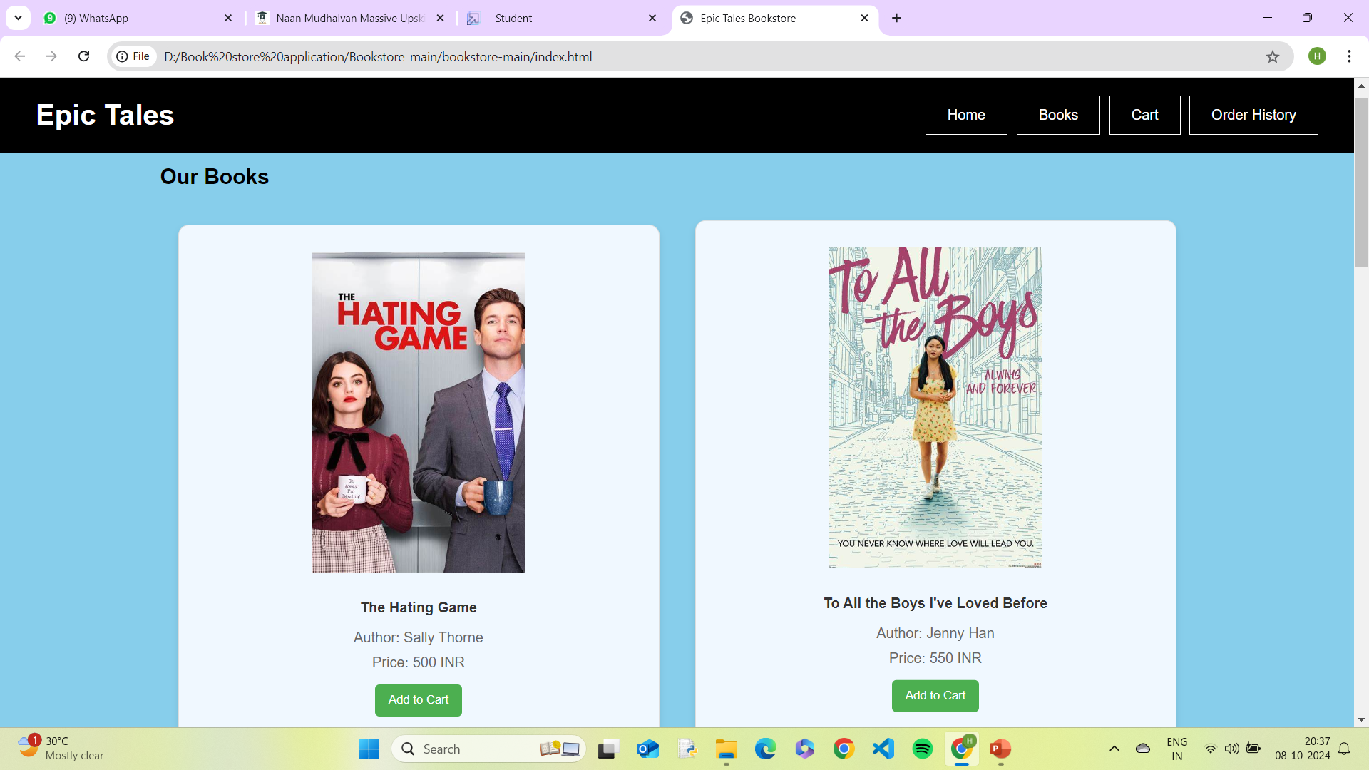

Slide 7
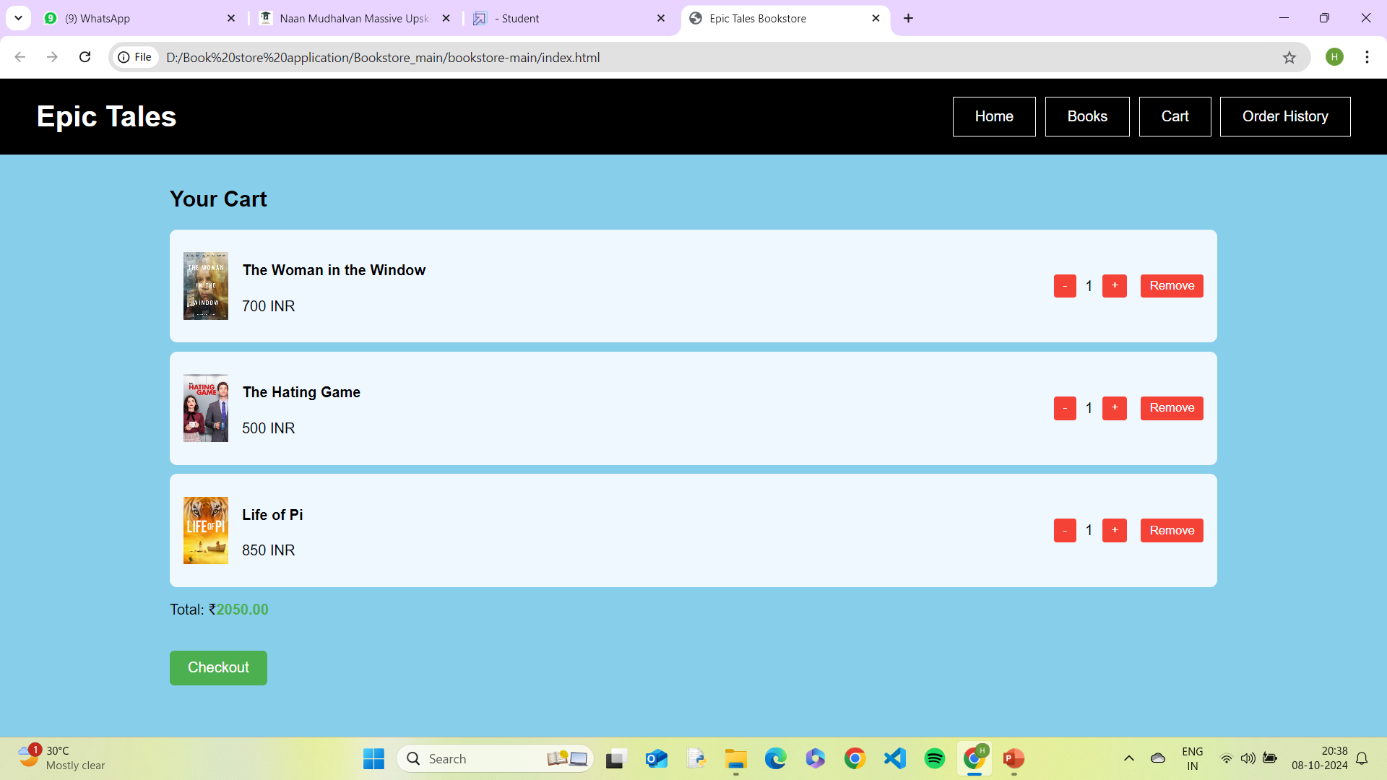
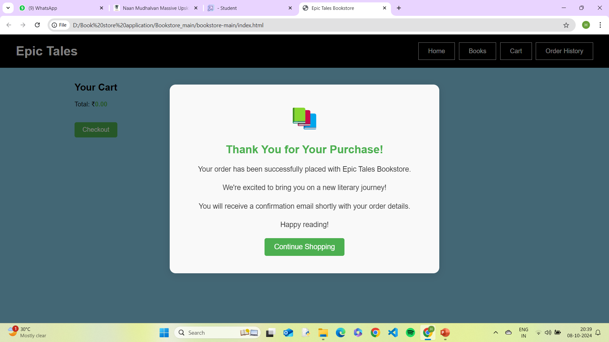

Slide 8
PRE-REQUISITES
1. Development Environment
Node.js & npm: Installed to manage packages and run the backend (download from Node.js website).
MongoDB: Install MongoDB locally or use MongoDB Atlas for cloud-hosted solutions.
Code Editor: Recommended: Visual Studio Code (with extensions for linting, React, and MongoDB).
Version Control: Git for source code management (GitHub for project hosting).
Browser: Modern browser like Google Chrome (for React DevTools and testing).
2. Librarires and Tools
React: Install via npx create-react-app.
Express & Node.js: Install via npm (npm install express).
Mongoose: For MongoDB object modeling (npm install mongoose).
Axios/Fetch: For making HTTP requests from the frontend (npm install axios).
JWT (jsonwebtoken): For authentication (npm install jsonwebtoken).
Stripe/PayPal SDK: For payment integration.

Slide 9
ARCHITECTURE
1. Frontend (React)
React.js: Dynamic, interactive UI.
Components: Reusable UI elements (Book List, Search, Cart).
Routing: Client-side navigation with React Router.
State Management: Redux or Context API for handling state (cart, user data).
Frontend: Hosted on Netlify/Vercel.
2. Backend (Node.js & Express)
Node.js: JavaScript runtime for server-side execution.
Express.js: Backend framework for API routes (RESTful APIs: GET /books, POST /checkout).
Business Logic: Handles user authentication, book searches, and order processing.
Backend: Node.js/Express deployed on Heroku/AWS.

Slide 10
3. Database (MongoDB)
NoSQL Database: Flexible data storage for books, users, and orders.
Collections:
Books: Title, author, genre, price, stock.
Users: Profiles, login data (JWT).
Orders: Transaction and shipping details.
4. Authentication & Security
JWT (JSON Web Token): For secure user login and session management.
OAuth: Third-party login options (Google, Facebook).
5. Payment Integration
Stripe/PayPal: Secure payment gateway for handling transactions.

Slide 11
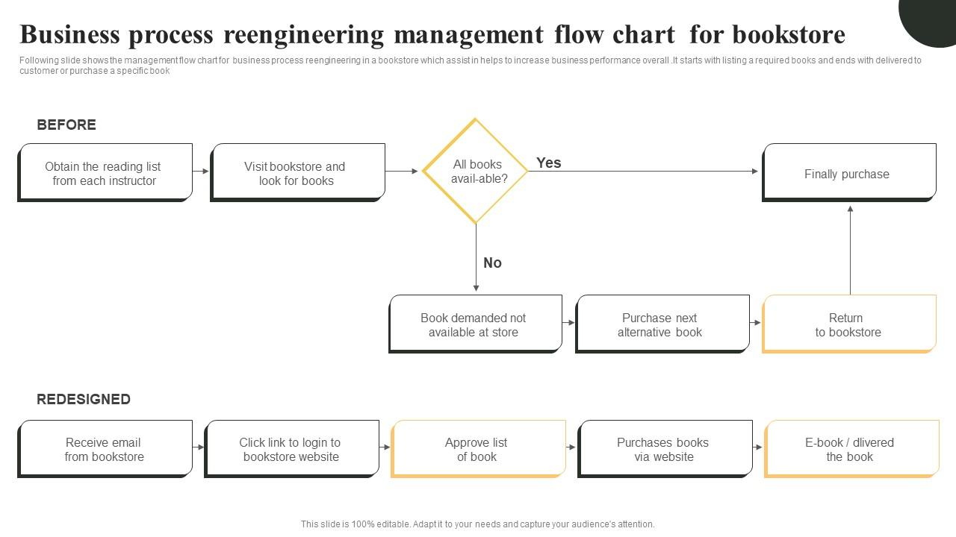
FLOWCHART

Slide 12
CONCLUSION
The bookstore website has been crafted to provide an engaging, efficient, and user-friendly platform for book enthusiasts. By combining a broad selection of titles, intuitive search features, and a secure checkout process, it ensures a seamless experience from browsing to purchase. With its responsive design, the website caters to users across all devices, enhancing accessibility and convenience.
By prioritizing personalized recommendations and a diverse collection, it aspires to be the go-to destination for readers of all kinds. This platform not only simplifies the process of buying books but also fosters a love for reading, making it a valuable resource for book lovers in the digital age.

Slide 13
THANK YOU!!

